Slide 1
Problem Statement Title Dashboard For Real-time Monitoring Of Construction Projects
Ministry: Ministry of Power
PS Code: SIH1295
Team Name: Telemetry Techies
Team Leader Name: Bruhathi S
Institute Code (AISHE): C-16532
Institute Name: Rajalakshmi Institute of Technology
Theme Name: Transportation & Logistics

Slide 2
Problem Statement
Designing of dashboards for Real-time monitoring of Construction projects using IOT devices and backend Artificial intelligence/ML tools to track Resources in the form of equipment/manpower, monitor their efficiency and safety in all situations.
Inaccurate Progress Monitoring
Inefficient Resource Allocation
Safety Risks
Ineffective Training
Data Analysis Challenges

Slide 3
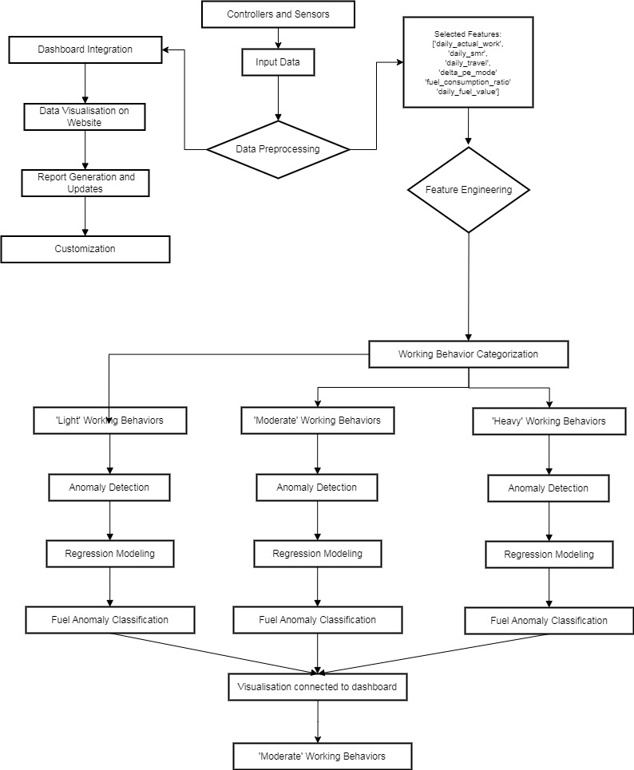
Idea / Approach
Comprehensive Project Lifecycle Coverage:
Our solution addresses every stage of a construction project, improving resource management, safety, data analysis, and workforce training.

Slide 4
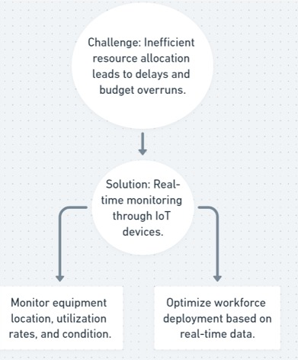
Idea / Approach
Real-Time Resource Tracking and Optimization:
We not only track resources in real-time but also optimize their allocation, reducing project costs and delays.
Error alerts are promptly communicated to project owners regardless of their priority.

Slide 5
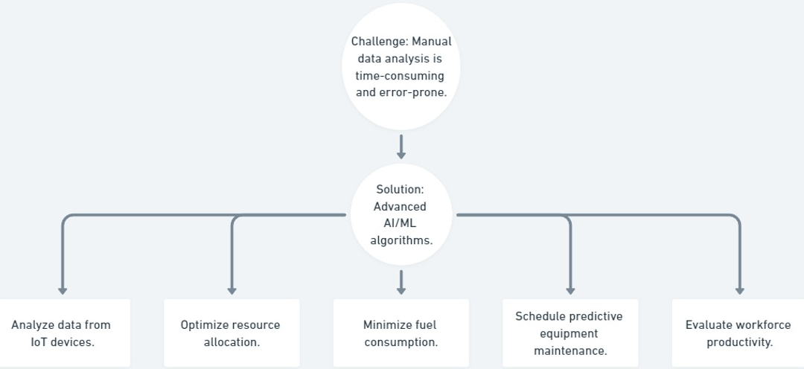
Idea / Approach
AI and Machine Learning Data Analysis:
AI and machine learning are employed to analyze construction data.
This analysis optimizes resource usage, fuel consumption, maintenance scheduling, and workforce productivity, potentially leading to significant cost savings and machine health monitoring.

Slide 6
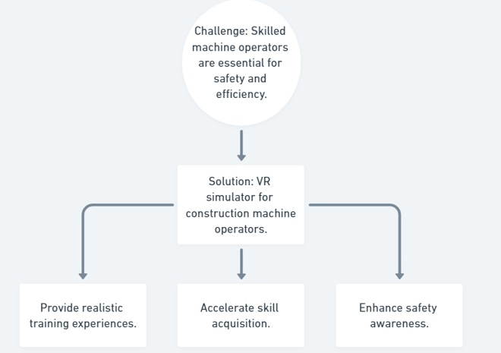
Idea / Approach
Immersive VR Training:
Our solution offers immersive VR training for machine operators.
This unique approach enhances skill development and safety awareness in the construction industry.

Slide 7
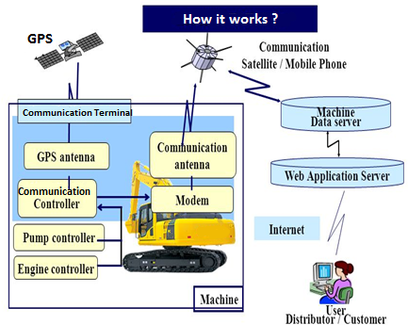
Flow chart of data collection & storing in server

